Slide 1
0-1.5, 0-2.5, 0-5, 0-7.5
0-8, 0-10, 2.5-5, 5-7.5
5-10, 7.5-10
0-12, 0-15
0-18, 0-20
2-15, 2-20
5-15, 5-20
6-15, 7.5-20
10-20, 15-20
0-25
0-30
7.5-15
10-15
10-20
10-30
15-20
15-30
20-30
0
10
20
30
40
50
60
70
80
90
>100
0-10
Surface soil
0-20
0-30
30-40
30-50
30-60
30-70
30-75
30-80
30-90
40-50
40-60
40-70
40-80
40-90
50-60
50-70
50-75
60-70
60-80
60-90
60-100
90-100
90-120
Subsurface soil

Slide 2
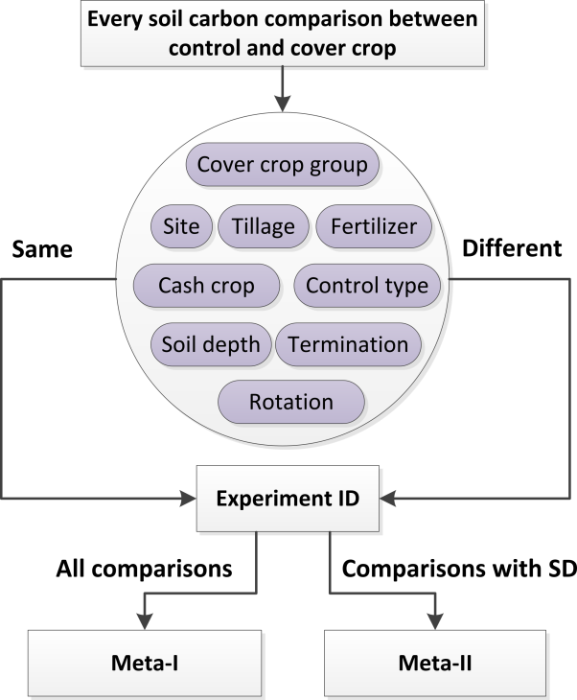
Data processing
Systematic review
Quality control
Meta-analysis
Digitization and data integration
Soil health calculator
Paper collection and selection
Experiment protocol

Slide 3
Soil O horizon
Leaves, debris
0-1.5, 0-2.5, 0-5, 0-7.5
0-8, 0-10, 2.5-5, 5-7.5
5-10, 7.5-10
0-12, 0-15
0-18, 0-20
2-15, 2-20
5-15, 5-20
6-15, 7.5-20
10-20, 15-20
0-25
0-30
7.5-15
10-15
10-20
10-30
15-20
15-30
20-30
0
10
20
30
40
50
60
70
80
90
100
Surface soil
0-10
30-40
30-50
30-60
30-70
30-75
30-80
30-90
40-50
40-60
40-70
40-80
40-90
50-60
50-70
50-75
60-70
60-80
60-90
60-100
90-100
90-120
Subsurface soil
Subsurface soil

